Slide 1

Employee Retention Software tool
Team5

Slide 2
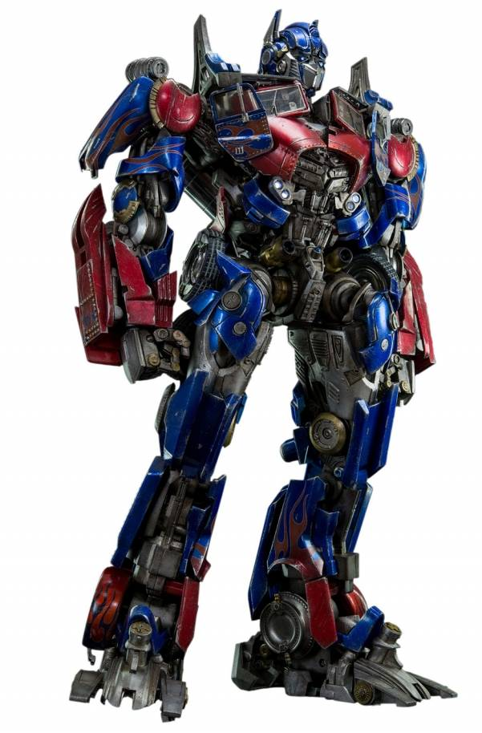
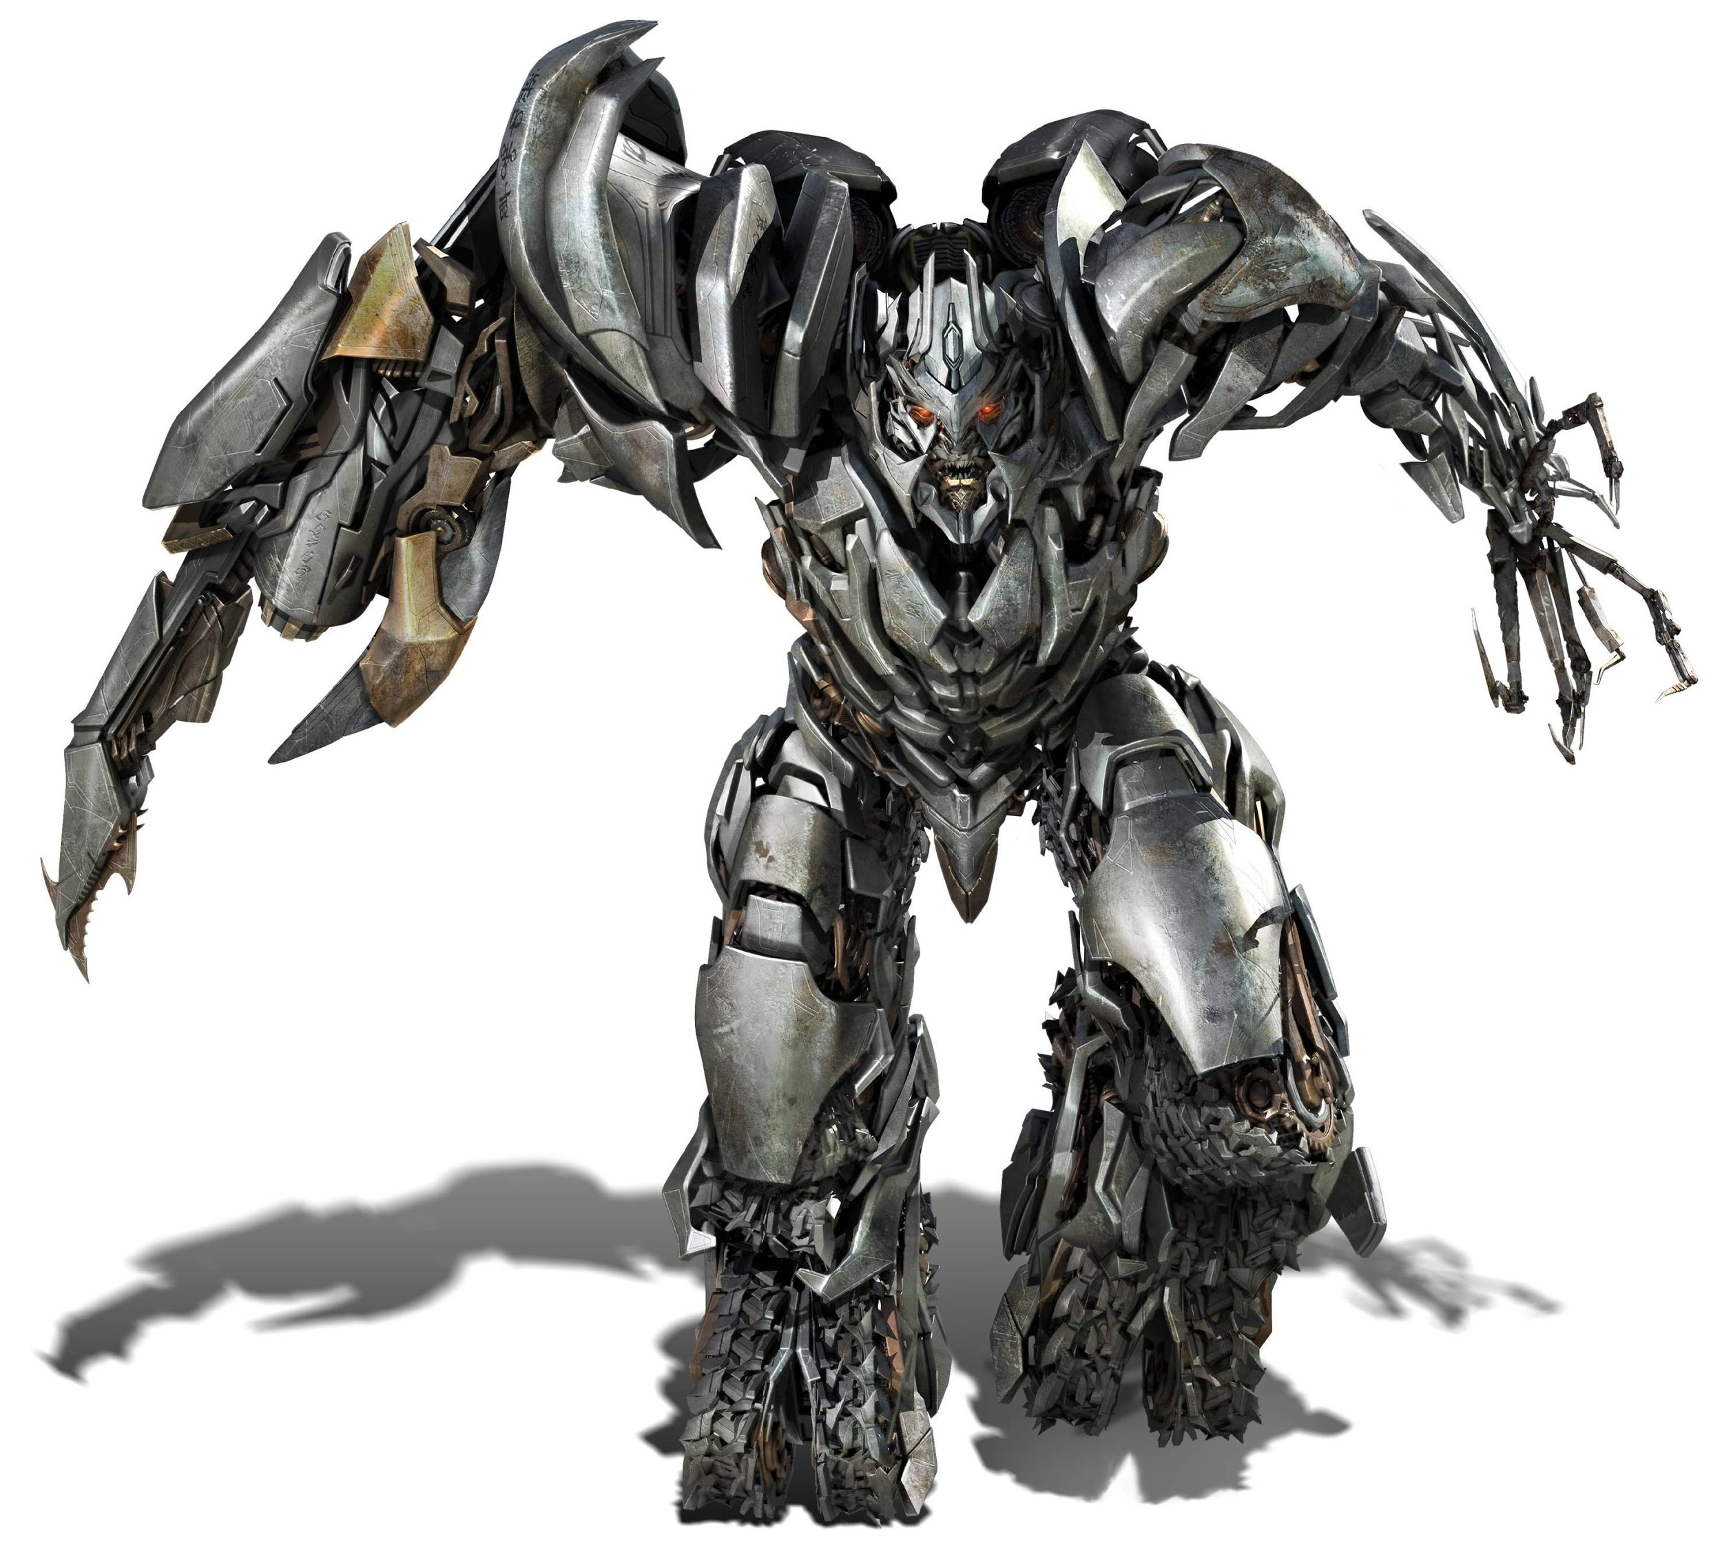
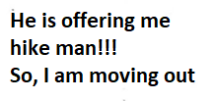

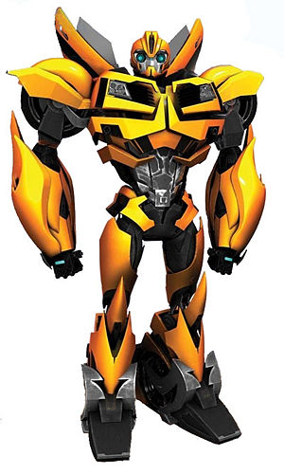
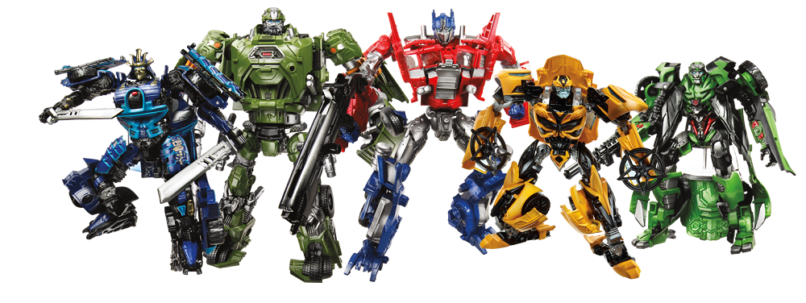
Employee Attrition
http://www.playbuzz.com/theweeklywarlock10/wich-transformer-are-you
https://wallpapercave.com/megatron-wallpapers
Notes:
Back to back attrition during critical projects/tasks going on

Slide 3

What is the cost?
Cost:
6 - 9 months of employee’s salary.
Sources of cost:
Hiring process: Advertising, Interviewing, Screening, and Hiring.
Onboarding process: Training and Mentoring efforts
Lost productivity
Morale of workforce/butterfly effect
Loss of institutional knowledge, satisfied customers
Study on costs:
For an employee who earns $80,000 a year,
cost ~ $40,000 - $60,000 for replacement process.
http://www.jkentstaffing.com/headlines/top-reasons-for-high-employee-turnover
Notes:
retaining valuable employees is essential for maintaining institutional knowledge, high morale, satisfied customers, and even sales growth.
Main purpose of our product is to predict employee attrition in a company and further seek out specific reasons affecting employee attrition problem in that company.

Slide 4

Attrition Factors and Control
http://www.acengage.com/downloads/infographics/
Notes:
retaining valuable employees is essential for maintaining institutional knowledge, high morale, satisfied customers, and even sales growth.
Main purpose of our product is to predict employee attrition in a company and further seek out specific reasons affecting employee attrition problem in that company.

Slide 5


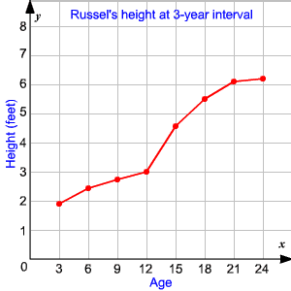
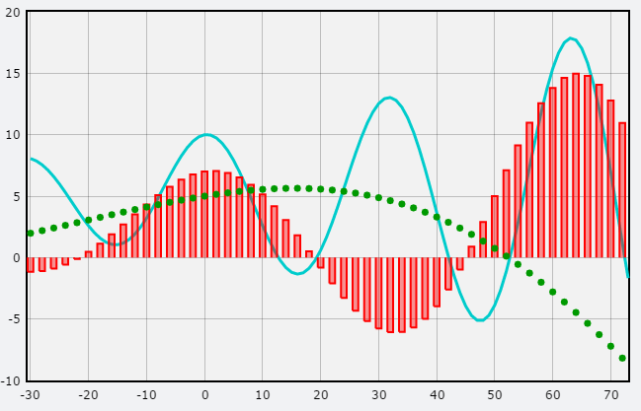
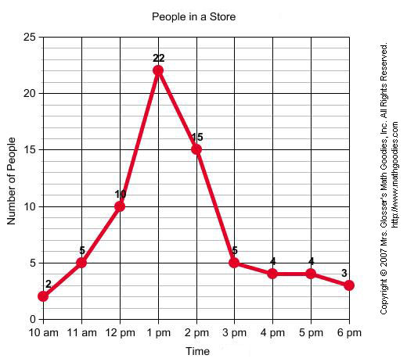
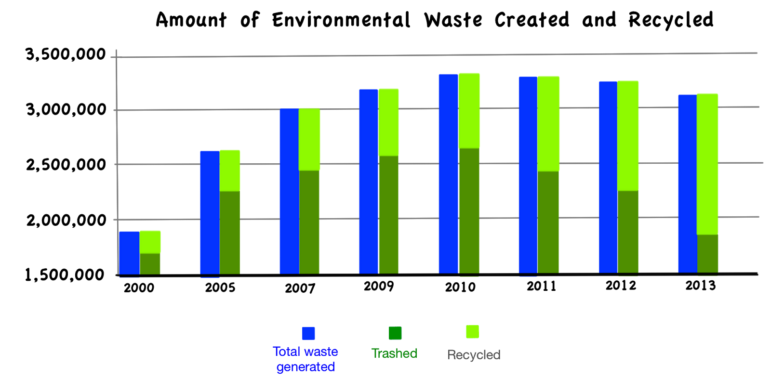
How can I retain my employee?
Employee Retention Software tool
Predicts Employee Attrition
Finds indicators affecting Attrition
https://actonvideo.com/videos/whiteboard-animation-video/
Notes:
retaining valuable employees is essential for maintaining institutional knowledge, high morale, satisfied customers, and even sales growth.
Main purpose of our product is to predict employee attrition in a company and further seek out specific reasons affecting employee attrition problem in that company.

Slide 6
Problem Statement
Data : IBM HR analytics employee attrition and performance
1,470 records with 35 features
Target : Attrition (Yes, No)
Predictors : 26 numerical, 8 categorical
Objective :
to predict Employee Attrition (Yes, No)

Slide 7
Logistic Regression
We investigate only the significant predictors with high odds ratios:
For one unit increase in the following variables:
Variables | The odds increase of an employee ... | Compared to the odds of an employee | The number of odds increase by...
EnvironmentSatisfaction | Retaining | Qutting | 43%
JobSatisfaction | Retaining | Qutting | 43%
JobInvolvement | Retaining | Qutting | 67%
PerformanceRating | Quitting | Retaining | More than twice!
BusinessTravel_Travel_Frequently | Quitting | who never travel for the business | More than 9 times
BusinessTravel_Travel_Rarely | Quitting | who never travel for the business | Almost 4 times larger
Notes:
Therefore, an employee who travel for the business is likely to quit the job.

Slide 8
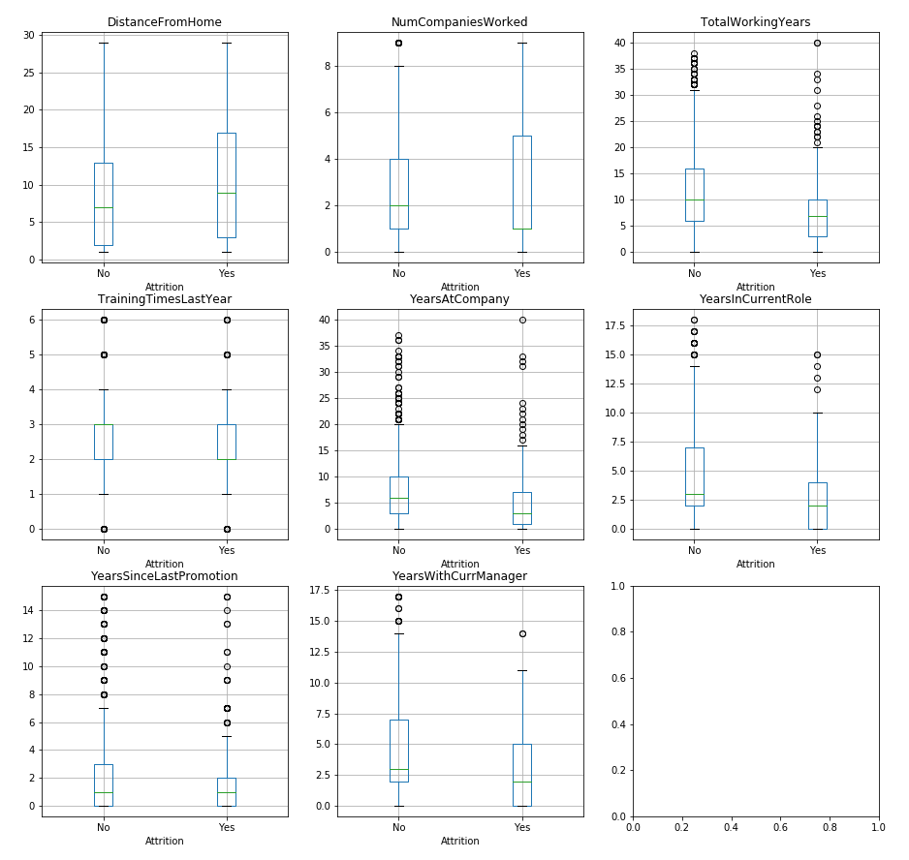
Logistic Regression

Slide 9
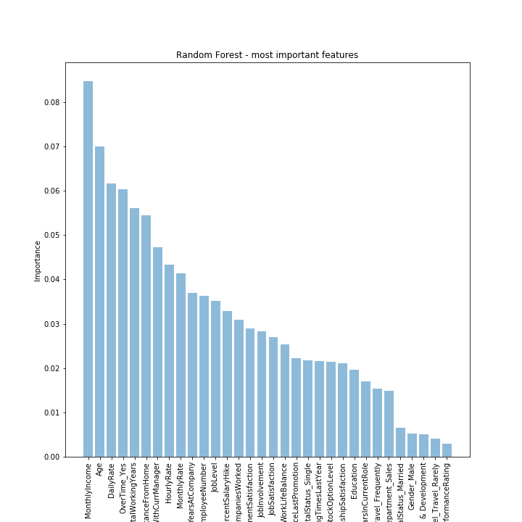
Random Forest
Importance Features
(cutoff = 0.04)
MonthlyIncome, Age, DailyRate, OverTime, TotalWorkingYears, DistanceFromHome, HourlyRate, YearsWithCurrentManager, and MonthlyRate

Slide 10
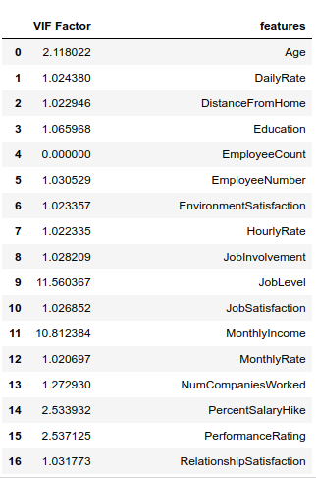
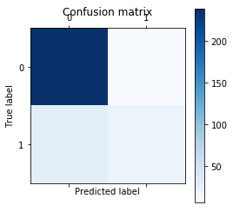
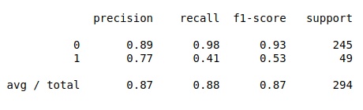
LDA
Accuracy = 88.06%

Slide 11
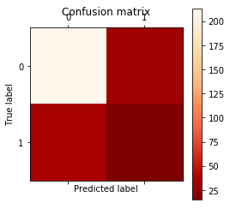
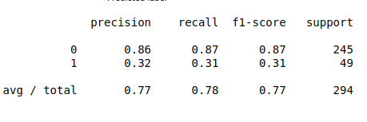
QDA
LDA Works Better than QDA !!
Accuracy = 80.61%

Slide 12
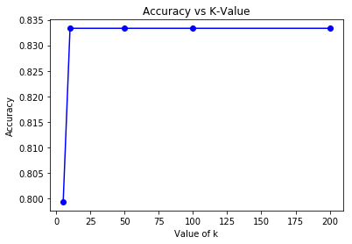
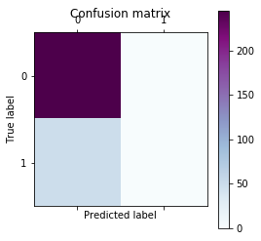
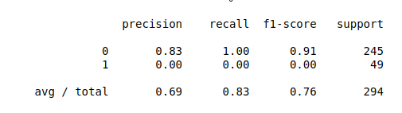
KNN
Accuracy = 83.34%

Slide 13
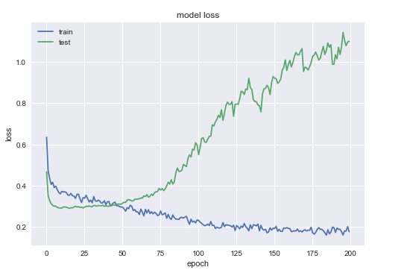
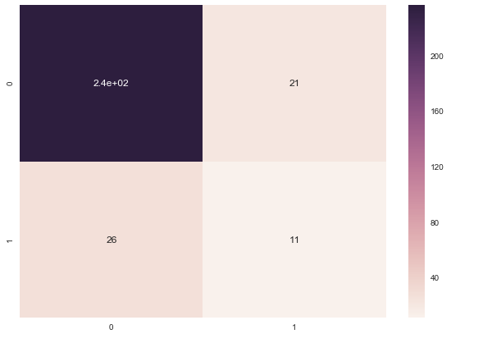
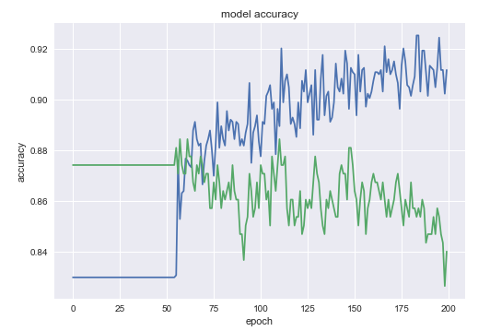
Neural Network

Slide 14
Conclusion
 | Attrition Prediction
Technique | Accu racy | Precision |  | Recall
 |  | Average | Class1 | Average | Class1
Logistic Regression | 0.89 | 0.89 | 0.84 | 0.89 | 0.43
Random Forest | 0.84 | 0.81 | 0.58 | 0.84 | 0.22
LDA | 0.88 | 0.87 | 0.77 | 0.88 | 0.41
QDA | 0.77 | 0.87 | 0.77 | 0.88 | 0.41
KNN (k = 10) | 0.79 | 0.71 | 0.00 | 0.80 | 0.00
Neural Network | 0.85 | 0.85 | 0.40 | 0.85 | 0.43
Potential quitting at IBM
- have higher performance rating
- often change jobs
- have less experience working
IBM should
quality of working environment
job involvement

Slide 15

Thank you
Q&A

Slide 16
Product Price
Based price = $10,000 Varied price = $1,600 * #employees
Ex: A company with 100 employees
Price = (10,000+160,000) = $170,000

Slide 17

Initial Investment
USD

